Slide 1
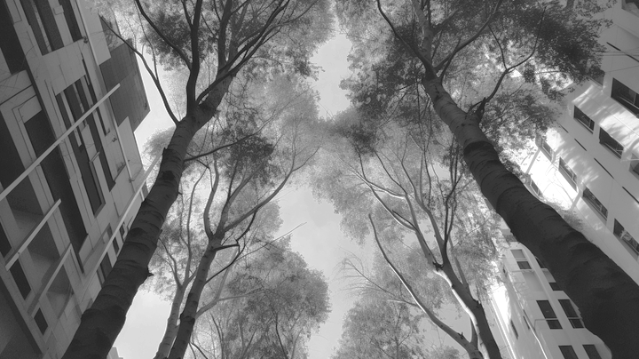


AIA //
STUDIO
+ FACULTY: ANGELOS CHRONIS
+ FACULTY: EBRAR EKE
+ FACULTY: ONDREJ VESELY
G03
+ LUCAS SENTIS FUSTER
+ MUSTAPHA NACHAR
+ REN RAINVILLE

Slide 2
1 / Concept

Slide 3
Concept / Problement Statement
The city of Melbourne experiences extreme heat during the summer season, and due to its low-density infrastructure, private cars are a common mode of transportation.
There is a need to provide safer and more sustainable transportation options that are not reliant on cars, particularly during the summer months. However, the high temperatures make it challenging for pedestrians, as they require shaded paths to avoid the harsh sun.

Slide 4
Concept / Proposal
To address the transportation issues in Melbourne, we propose an application that identifies the shortest shaded pathway for commuters. The app's primary objective is to encourage the use of non-car transportation modes while providing a comfortable and safer commuting experience, especially during the hot weather seasons

Slide 5


Concept / Methodology
Source
Data
Edge’s Weights
User’s Preference
Street Network
Edges
Search Address…
Building Geometry
Sun Hours
Shade
Tree Canopy
Water
Drinking Water
Distance < 30 m
Flat
Footpath Steepness
Slope > 1:25

Slide 6
2 / Data

Slide 7
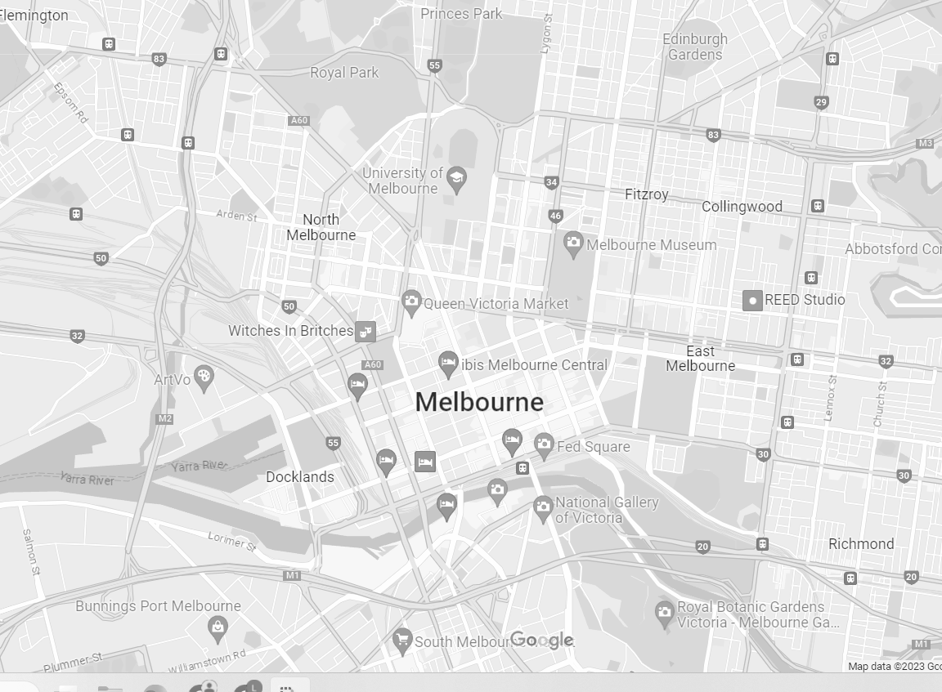
Data / City Zone
Data
Street Network
Building Geometry
Tree Canopy
Drinking Water
Footpath Steepness

Slide 8
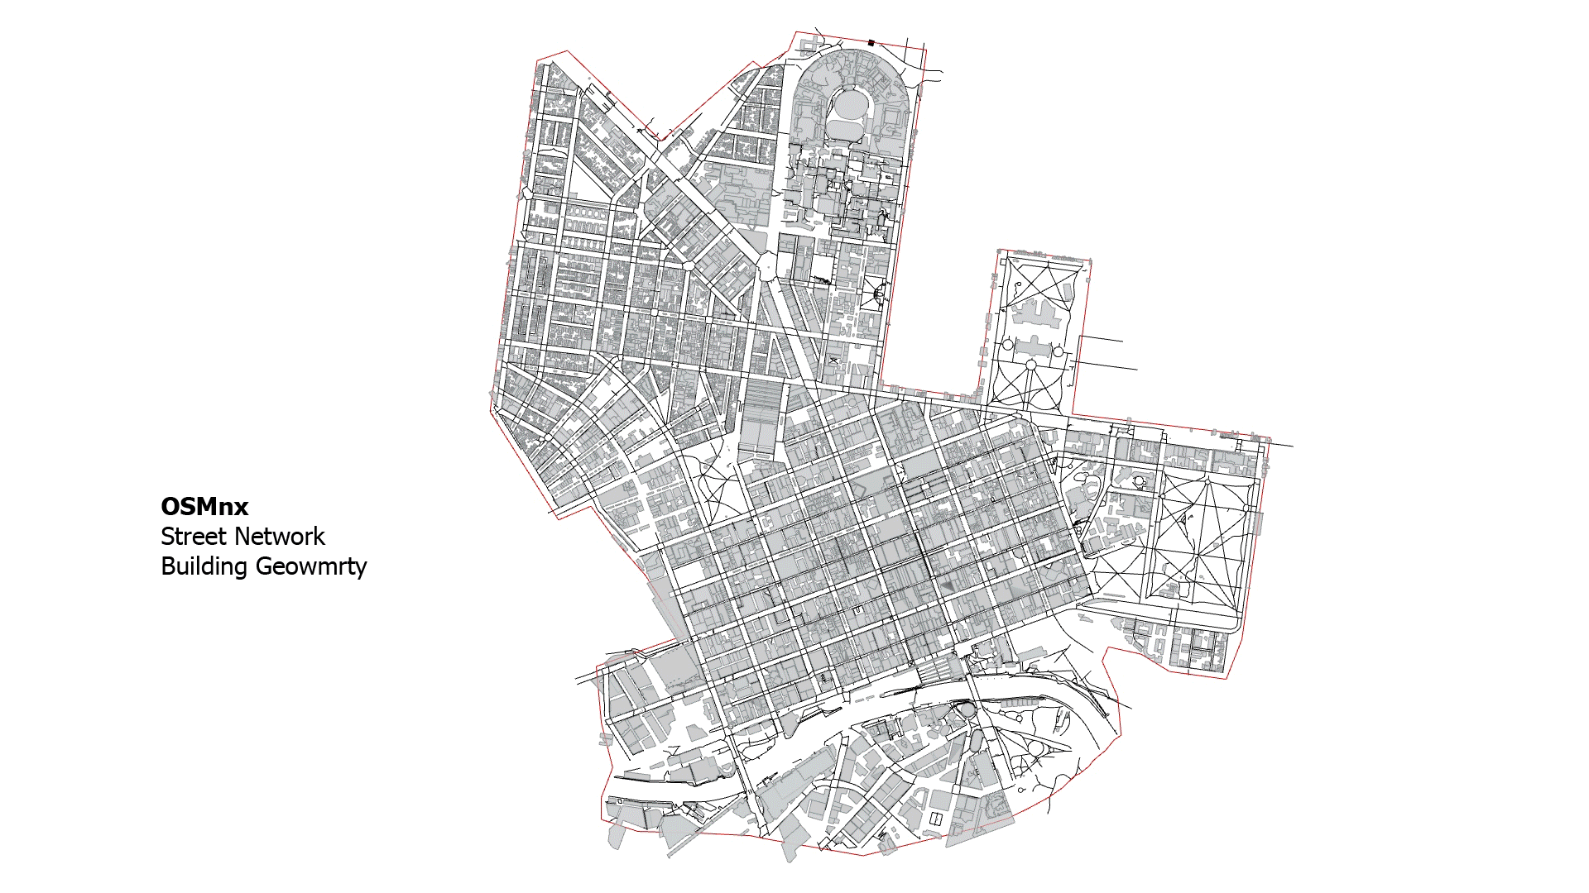

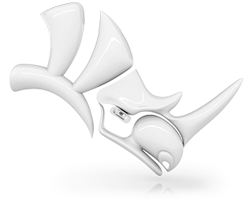
Data / Visualization
Clean the dataset and import it into GH
to generate the weights for the shortest path.

Slide 9
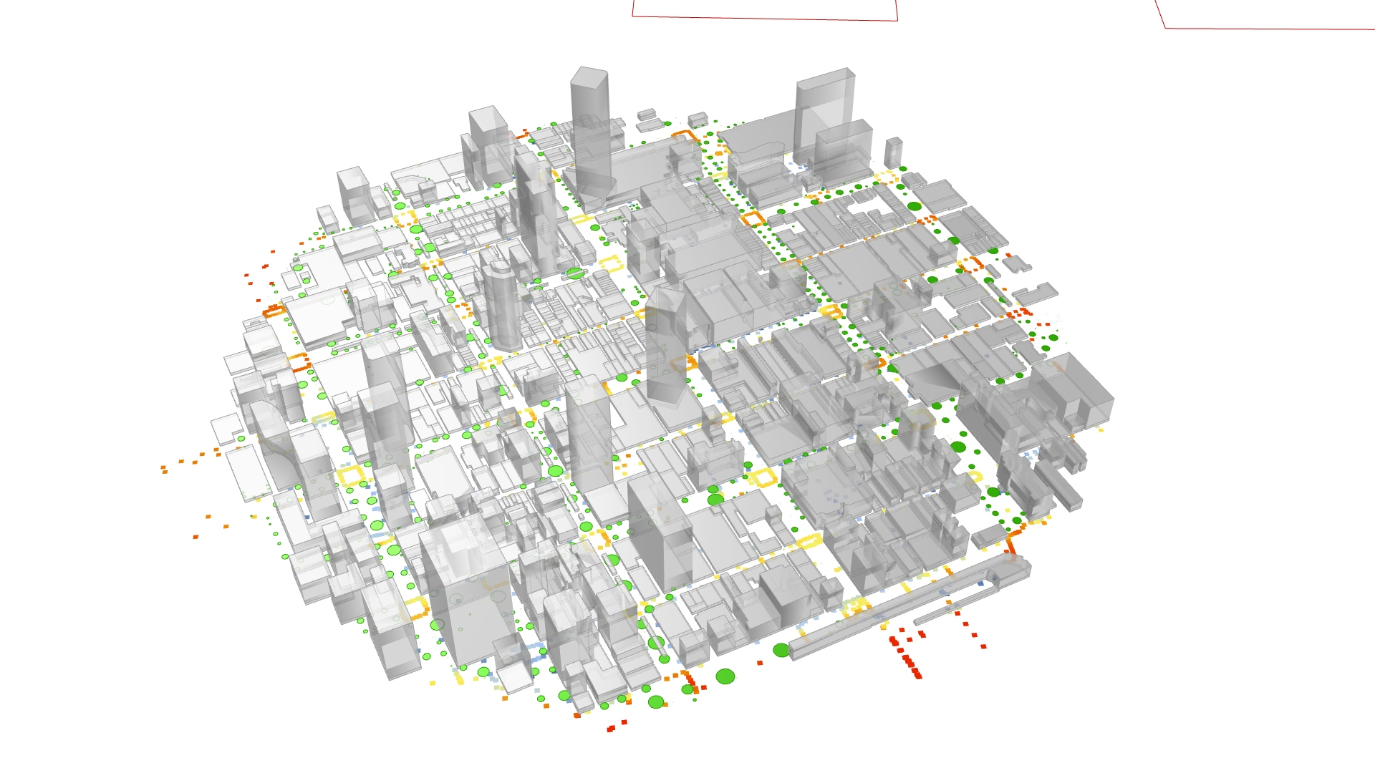
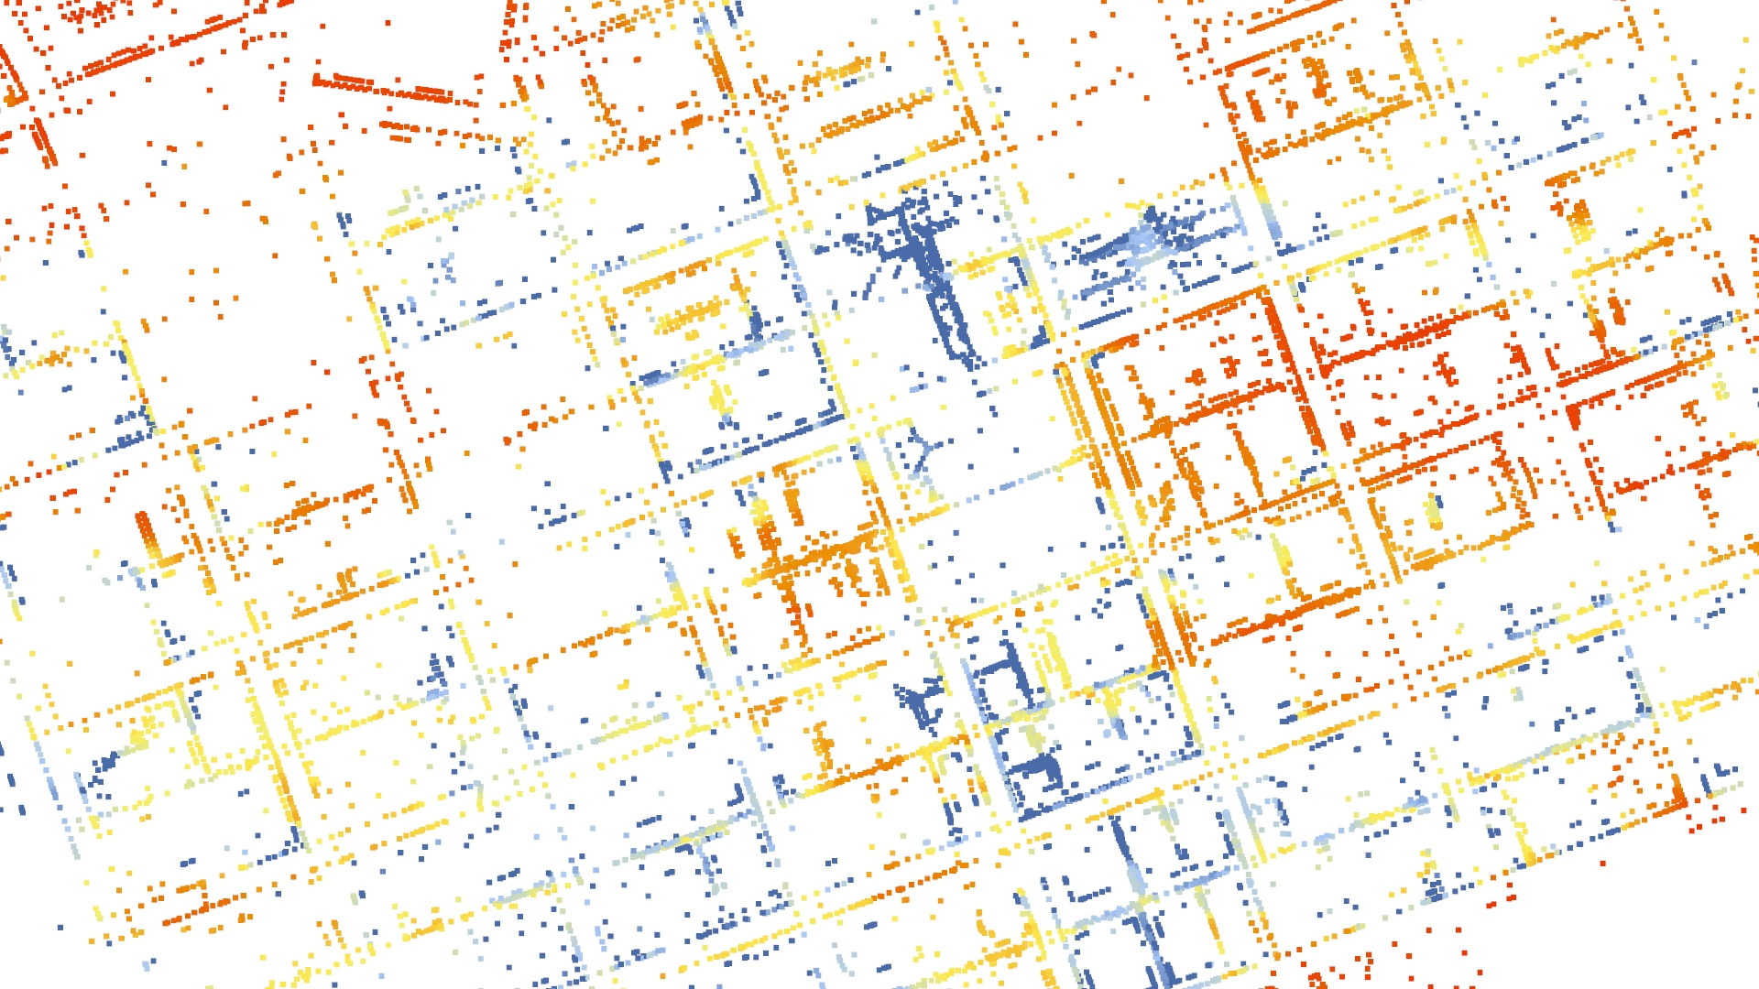
Data / Sun Hours
Calculate the Sun Hours for every edge center point during summer.
Building Geometry
+
Tree Canopy
Sun Hours
Months of Summer

Slide 10
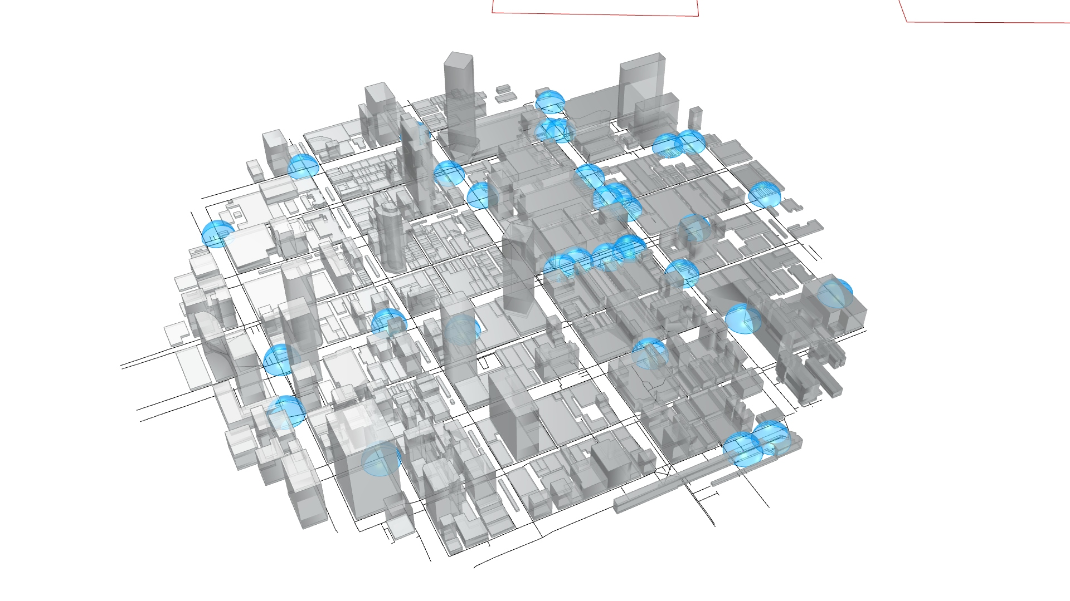
Data / Drinking Water
Classify the edges based on their proximity to a drinking water source point, distinguishing those within a 30-meter radius.
Drinking Water
Distance > 30m
True
False
30m

Slide 11
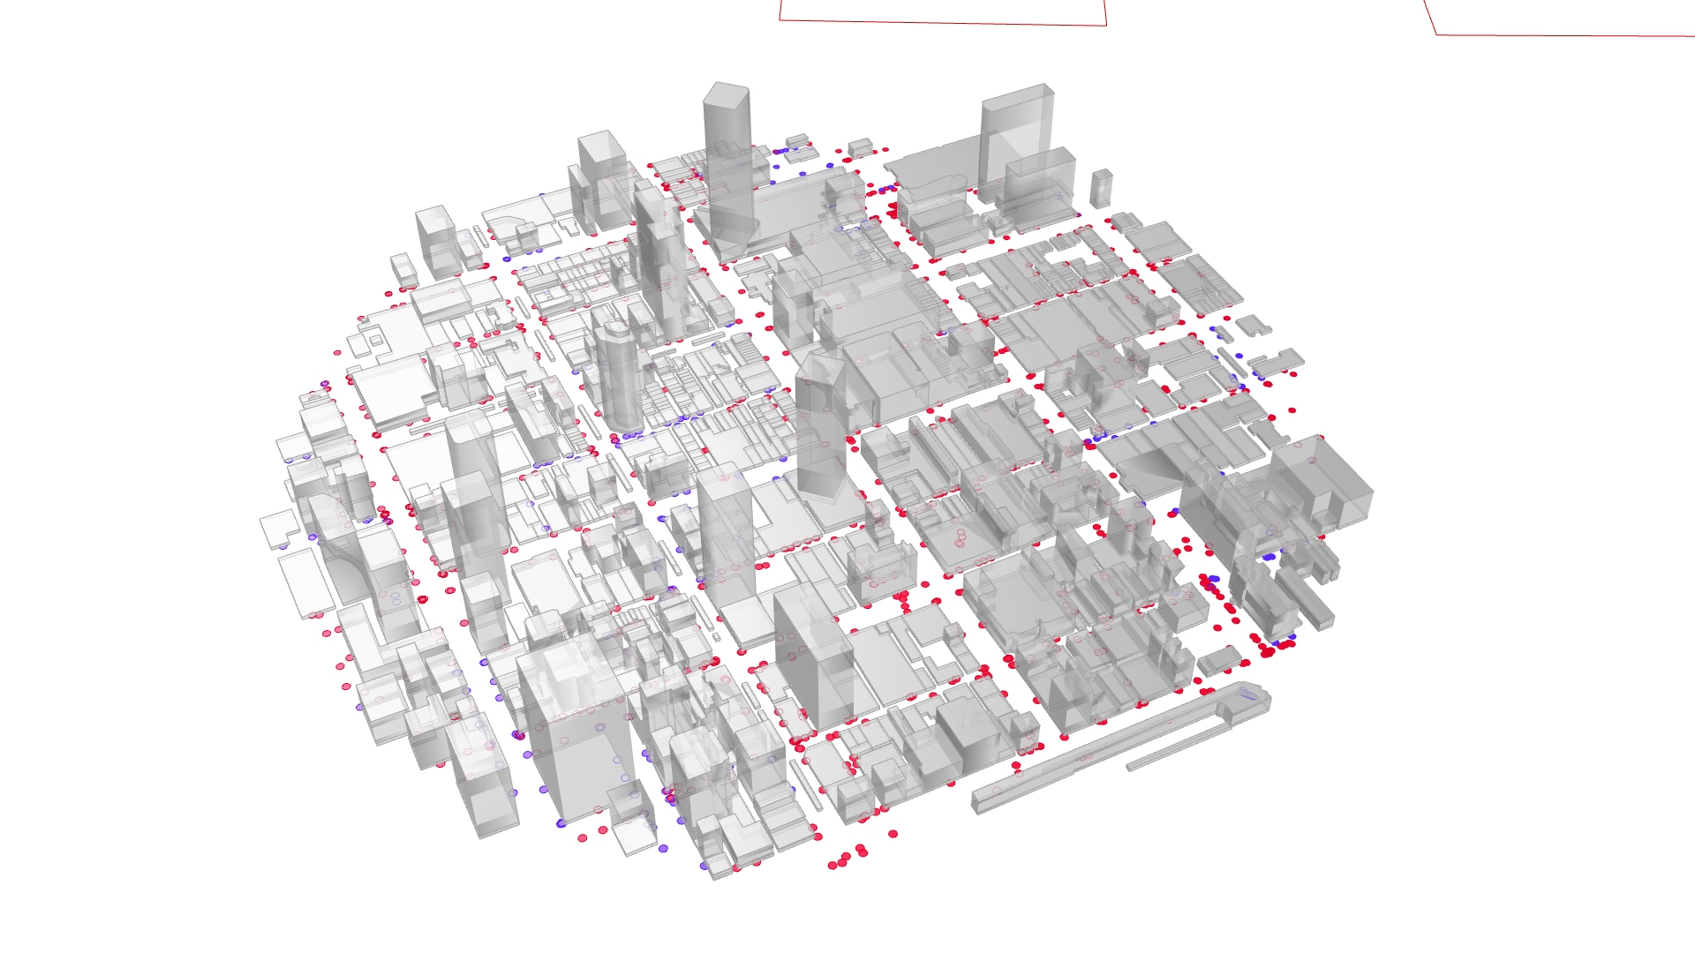
Data / Steepness
Classify the edges based on their steepness, distinguishing those with a slope greater than 1:25
Footpath Steepness
Slope > 1:25
True
False

Slide 12
3 / Shortest Path

Slide 13
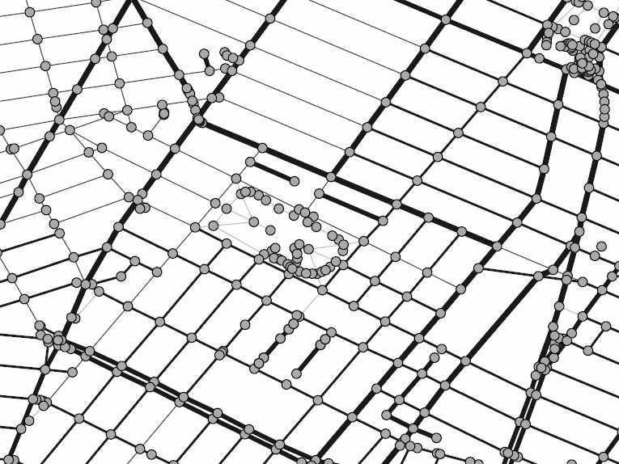
Shortest Path / Scoring System
Edge Weights
1_Length (Range: 0 to 1)
2_Sun Hours (Range: 0 to 1)
3_Steepness (T/F)
4_Drinking Water (T/F)

Slide 14
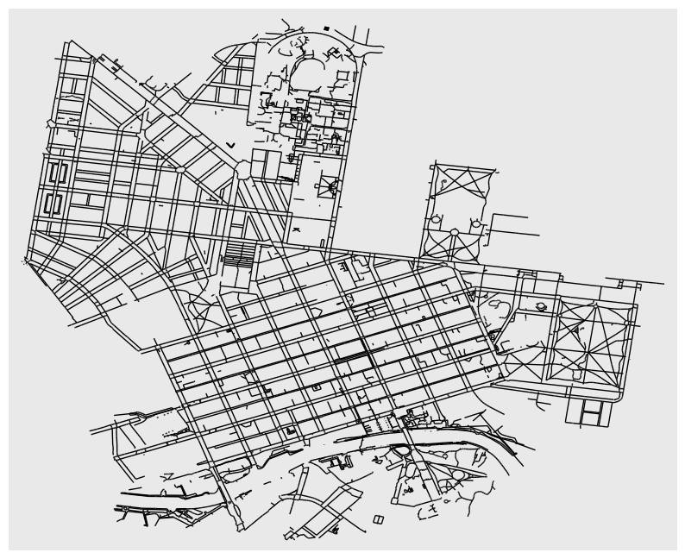
Shortest Path / Graph Dataset
Edge Dataset
vi | vj | length | sunhours | drink_water | steep
0 | 1 | 2 | 0 | 0 | 1
1 | 2 | 28 | 675 | 0 | 1
2 | 3 | 11 | 1187 | 0 | 1
3 | 4 | 5 | 1195 | 0 | 1
4 | 5 | 16 | 1206 | 0 | 0
5 | 6 | 6 | 1202 | 0 | 0
6 | 7 | 6 | 1191 | 0 | 0
7 | 8 | 5 | 1157 | 0 | 0
8 | 9 | 11 | 1020 | 0 | 0
Node Dataset
x | y | id
-37.81828876 | 144.9651714 | 0
-37.81830494 | 144.9651784 | 1
-37.81853728 | 144.9652851 | 2
-37.81862747 | 144.9653265 | 3
-37.81867102 | 144.9653466 | 4
-37.81880227 | 144.965411 | 5
-37.81885192 | 144.9654341 | 6
-37.81890286 | 144.9654578 | 7
-37.81894821 | 144.9654765 | 8

Slide 15
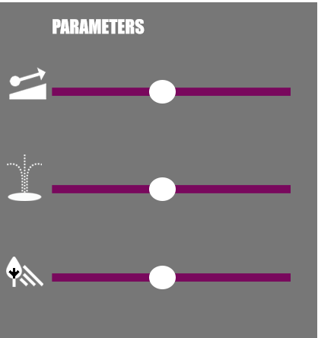
Shortest Path / Scoring System
#preferences: 0, 1 to 5, 0: don't include in weight,
#1: weight the most, 5: weight the least
#Sliders from App Provide these values
#checkbox for user to select which sliders to include in calculation
#if box is unchecked, Pref value = 0
lengthPref = 3
shadePref = 2
drinkPref = 3
steepPref = 5
combinedScore = np.array(lengthPref*edges['length'])
+ np.array(shadePref*edges['sunhours'])
+ np.array(drinkPref*edges['df'])
+ np.array(steepPref*edges['stp'])
geo_wieghtedEdge['combinedScore'] = combinedScore

Slide 16
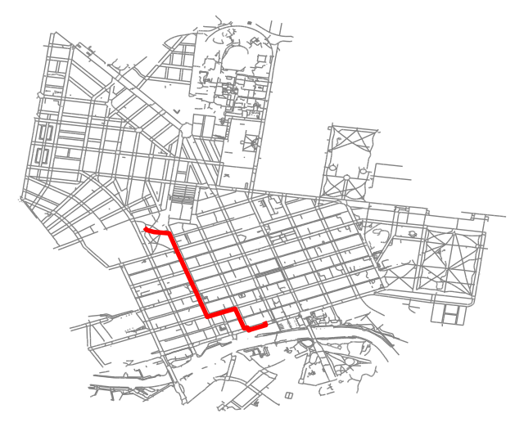
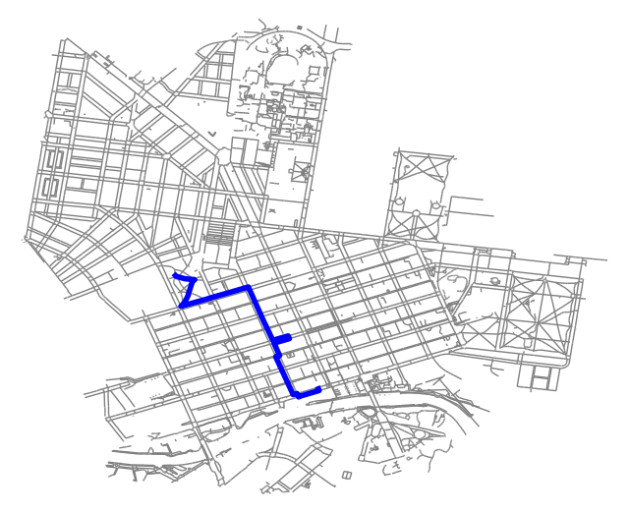
Shortest Path / Length vs Combined Score
Edge weight = Length only
Edge weight = Combined Score

Slide 17
4 / App

Slide 18
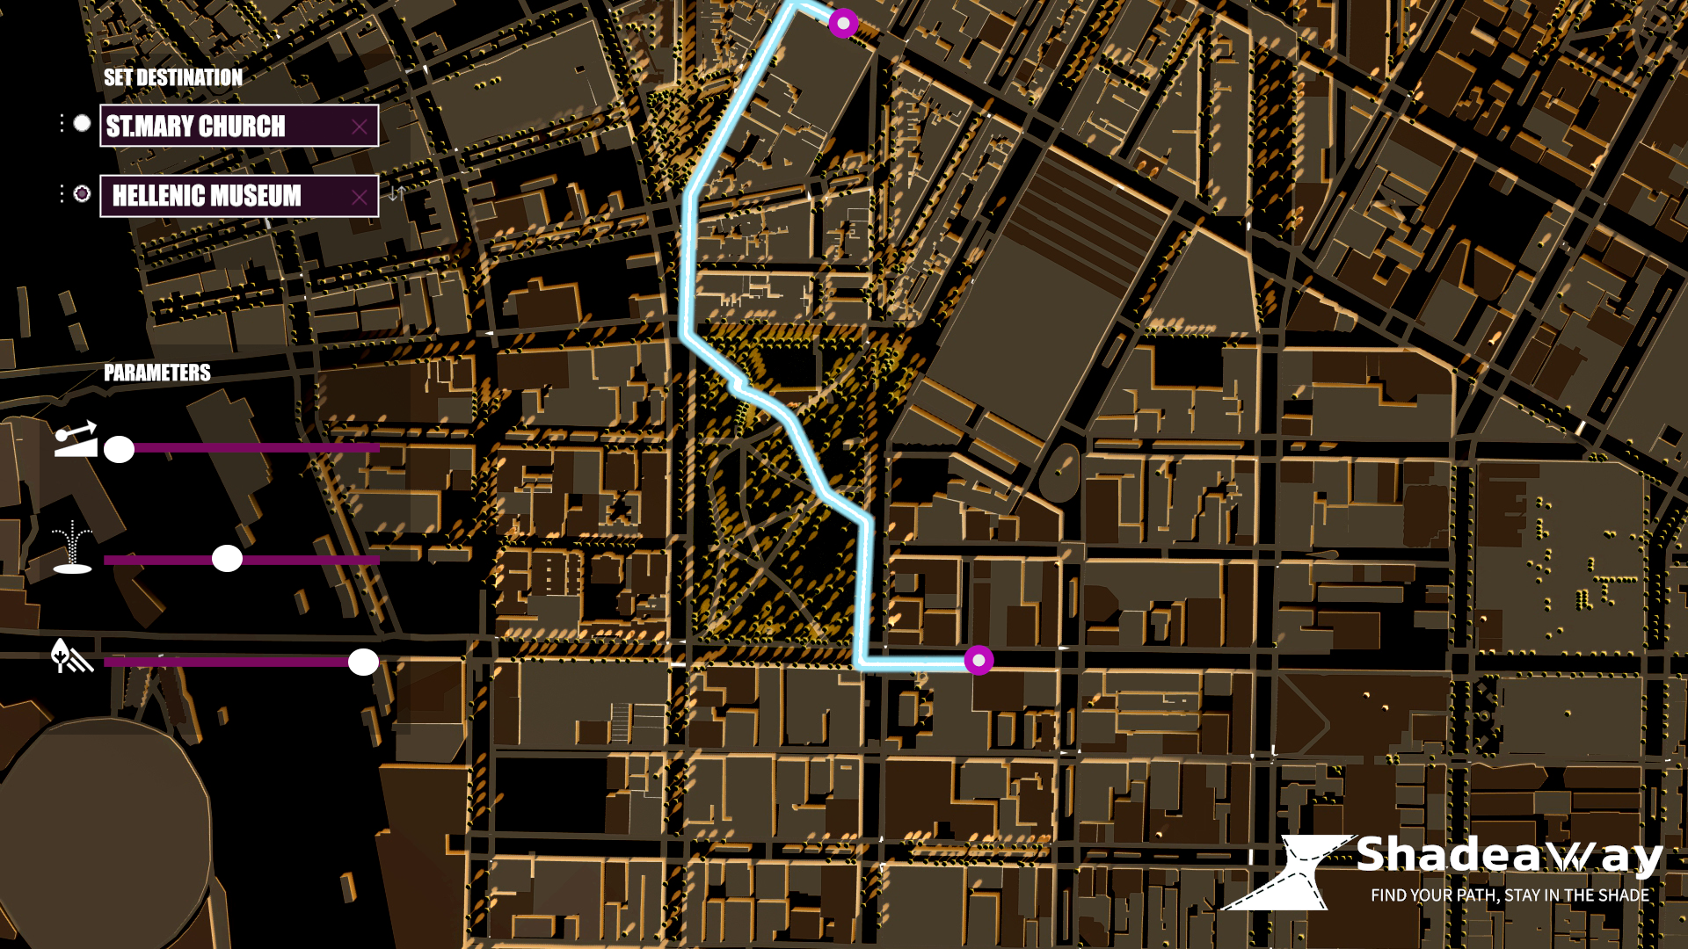
App / Interface

Slide 19

App / Video

